Slide 1

CANDU Fuel Bundle Analysis using MCNP
ENGPHYS 4NE3 Group 8
Wonseok Park
Muqtadir Hussain

Slide 2
Introduction
Focus on analysis of a CANDU reactor's fuel bundle and assembly structures
Analysis of fission reactions, specifically neutron interactions with nuclear fuels like Uranium 235, Plutonium 239 and Thorium Dioxide
Evaluating different fuel candidates and configurations to optimize power generation and/or minimize energy losses

Slide 3
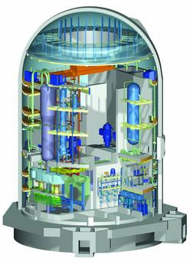
CANDU REACTOR
Key features:
CANada Deuterium Uranium
Pressurized Heavy Water reactor (PWR)
Natural uranium as a fuel
Heavy water moderator
Fuel bundles held in pressure tubes
On-line refueling
Horizontal fuel channels
Efficient use of uranium
Advantages:
Flexibility in fuel selection
Low enrichment requirements
On-line refueling
Applications:
Electricity generation
Industrial process heat applications
Notes:
Heavy water enables more efficient moderation of neutrons
Fuel bundles contained in horizontal pressure tubes in calandria
Online refueling: while reactor is operating, fuel bundles can be inserted or removed
Horizontal fuel channels: allows natural circulation of coolant and efficient heat transfer
Can use variety fuel types; natural uranium, thorium, recycled uranium/plutonium
Process heat applications: heating by hot water, industrial manufacturing, hydrogen production by steam reforming, since it produce high temperature steam
etc

Slide 4
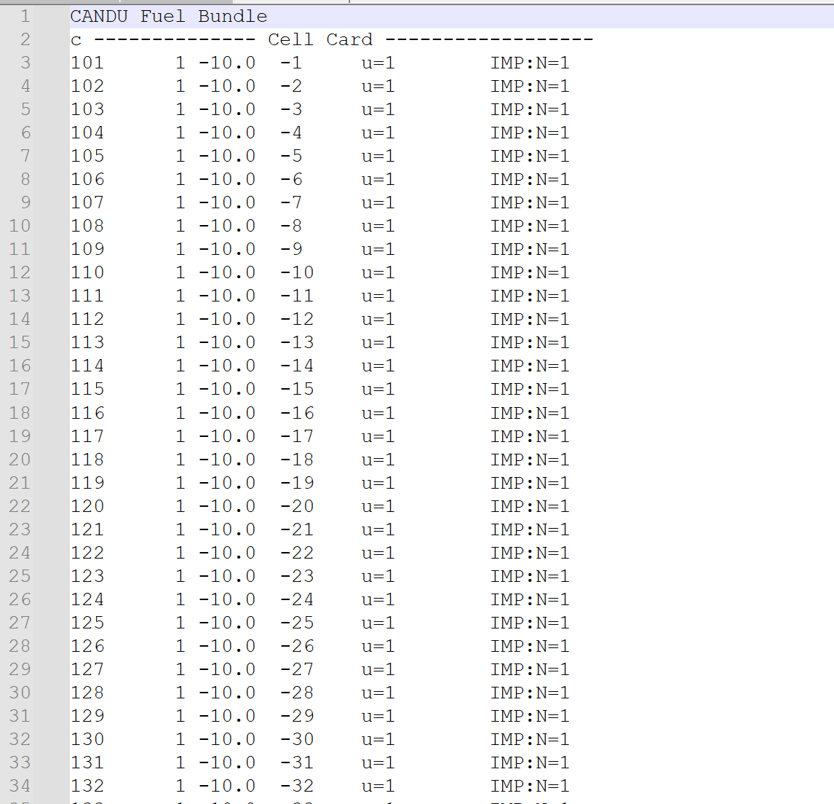
CANDU SIMULATION MODEL
Simplifications
Pin Lattice
Structure and cladding
Material composition
Geometry
Source
Absence of several phenomena
Simulation parameters
10000 neutron histories tracked
One neutron tracked per batch
Simulation consists of 20 batches
100 inactive cycles
13 initial source locations
Notes:
Pin lattice: the pin lattice simplification refers to the representation of these fuel pins within the reactor core in a simplified manner, often for computational convenience in simulations like MCNP. Instead of explicitly modeling each individual fuel pin within the lattice, the pin lattice is represented as a homogenized region with averaged properties
Homogenization: Instead of modeling each fuel pin separately, the entire region occupied by the pin lattice is homogenized. This means that the properties (such as material composition, density, and neutron cross-sections) of the fuel pins are averaged over the entire lattice region
Structure and cladding: the structures and cladding surrounding the fuels are using simplified geometries, in this case, cylinder, for reduced computational complexity. Actual geometry is more complex in real life.
Material composition: simplified isotopic compositions, not accounting detailed composition of isotopes and impurities.
Fuel, Calandria, pressure tubes, cladding, moderator/coolant
Geometry: basic shapes of cylinders and planes,
Source: neutron sources are simplified as isotropic point sources located at specific positions. In reality, they are distributed throughout the fuel assembly and may have directional characteristics
Absence of several physics model: neutron scattering, thermal hydraulics, or fuel depletion.
These are typically simplified in MCNP simulation to reduce computational burdens

Slide 5
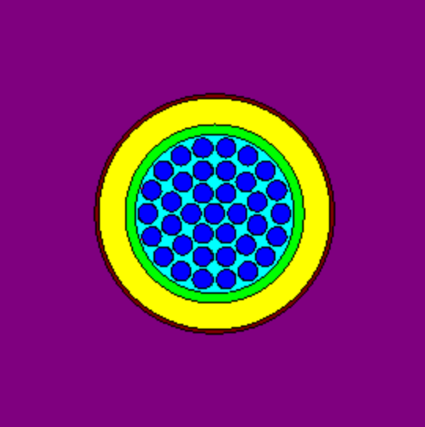
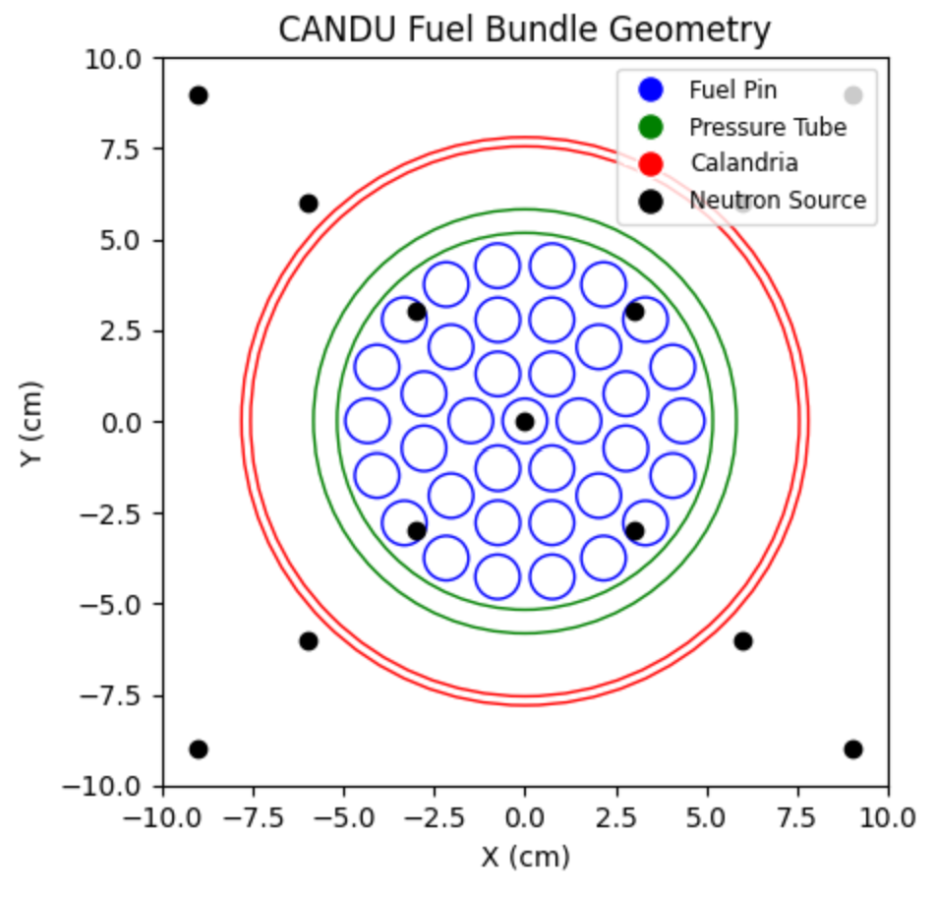
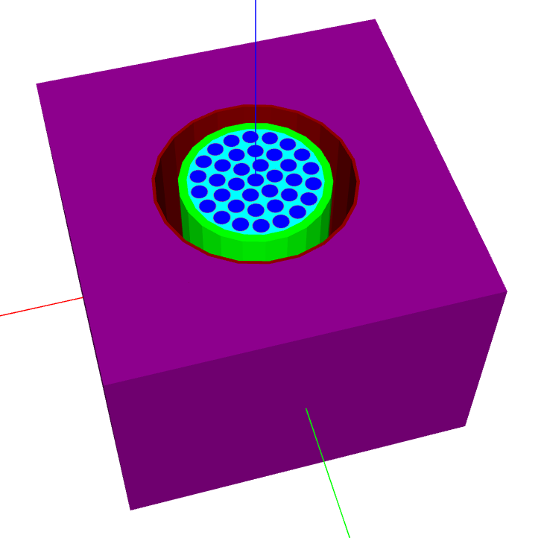
SIMULATION MODEL
Fuel
Cladding
Pressure tube
Calandria
Moderator/coolant
Fuel bundles arranged in ring pattern within the pressure tube within the calandria
Starting from midlle, expanding outwards
1,6,12,18 pins making 37 in total
Notes:
Fuel is natural uranium
Cladding, pressure tube, calandria is zirconium alloys
Due to mechanical properties, corrosion resistance, neutron transparency( low neutron absorption)
Space outside fuel pin and inside pressure tube is filled with light water, outside calandria is heavy water
Initial neutron source points defined. One thing to note is that in real life, they would be positioned near the fuel rods, but for here, for simplicity and feasibility of simulation they were selected arbitrarily. (to save time and computational resources)
For height, the surfaces are defined –10 to 10 cm, but in reality it is around 50cm

Slide 6
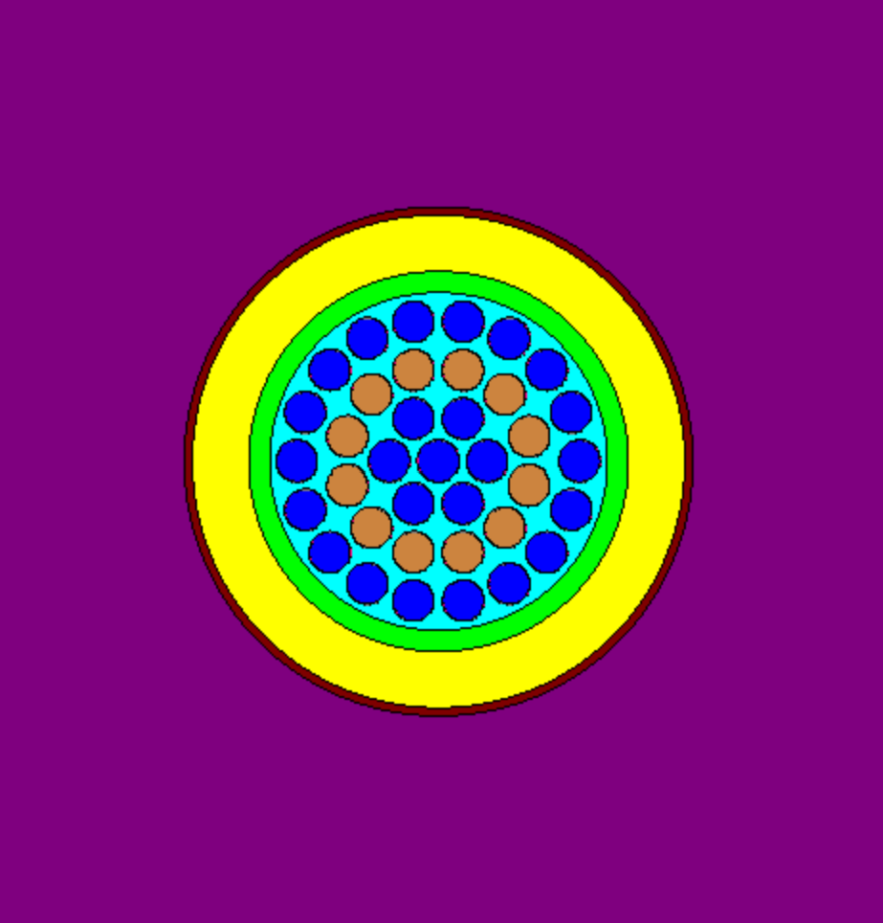
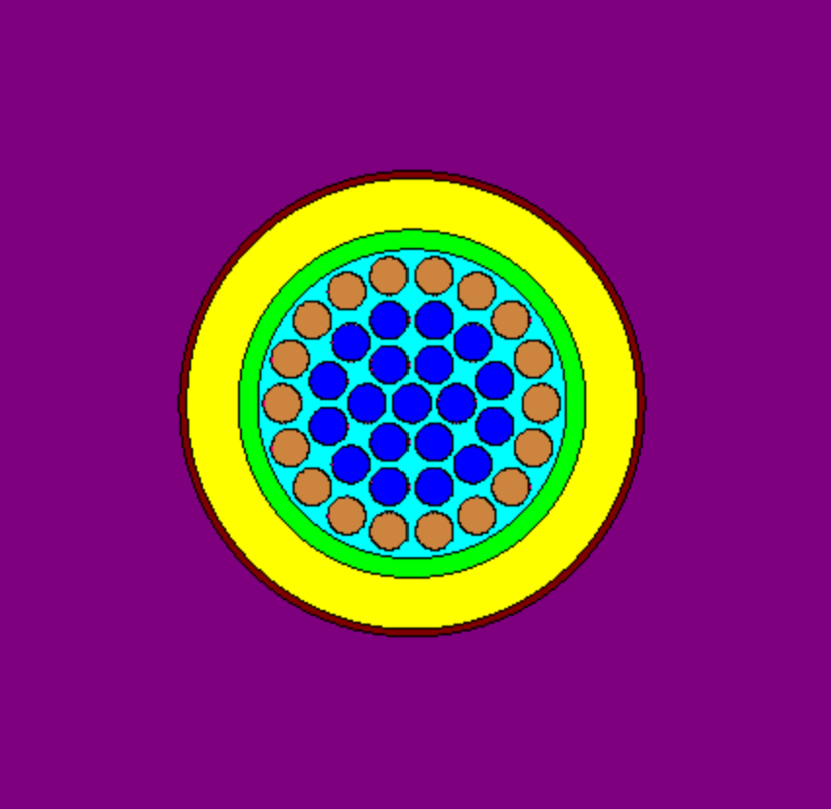
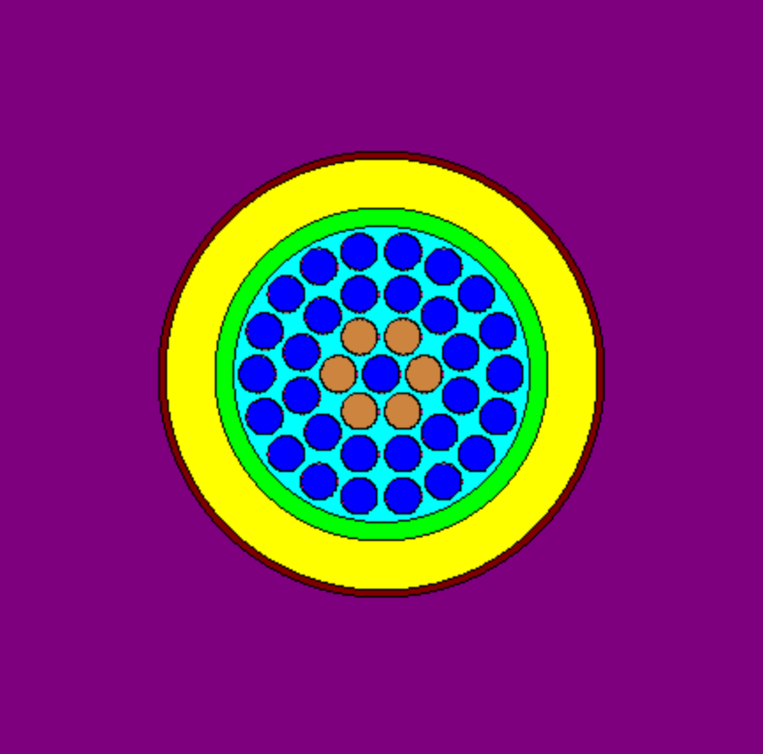
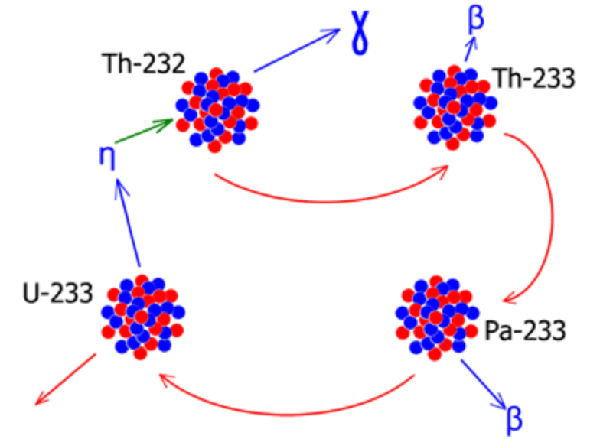
DUPLEX FUELING
Fissile material surrounded by fertile
Th-232 absorb neutron
Production of fissile isotope U-233
This helps extend reactor lifespan and efficient fuel burnup
Notes:
In duplex fuel design, fissile material (UO2) surrounded by fertile fuel (ThO2), here Th-232 is a fertile isotope, in duplex fuel what happens is that Th-232 absorb neutron and with a later (n,gamma) reaction produce fissile isotope U-233. This unique feature helps to extend reactor lifespan and efficient fuel burnup.
Why it increase reactor lifespan? Because of increased core conversion ratio.
From number of research already conducted, its core conversion ratio were higher in case of duplex fueling. High CCR (ratio of fissile created to fissile consumed)simply means that it is producing more then it consumes
Another advantage is use of thorium, which is available nuclear fuels compared to natural uranium. Its abundancy and extraction and processing of thorium can be simpler(involves less step) and potentially less expansive, although, the complete economics behind this is depends on various scenario involving factors such as market demand, waste management, regulatory environment, etc.
Th 232 absorbs neutron, transmuting to Th 233. It then beta decays to Protactinium 233 which decays again to U-233.
The ring arrangement for fertile materials is simply for optimization purposes since the specific arrangement can impact the results. For this, we were doing trial and error process to see which configuration would give best results

Slide 7
FUEL CANDIDATES
Natural Uranium
MOX Fuel (Mixed Oxide Fuel, a blend of Plutonium and Uranium)
Enriched Uranium
Thorium Dioxide – ThO₂ based fuels (Duplex Fuel Design)

Slide 8
RESULTS
Fuel Type | Average K-eff | Average Prompt Neutron Lifetime (μs) | Average Source Points Generated
Natural Uranium | 1.0240 | 80,000 | 9,950
MOX Fuel | 1.6935 | 41,623 | 10,000.5
Enriched Uranium | 1.5986 | 48,692.5 | 13,065.5
Thorium Dioxide 1st Ring | 0.9000 | 80,000 | 10,000
Thorium Dioxide 2nd Ring | 0.7480 | 80,655 | 8,857
Thorium Dioxide Last Ring | 0.4395 | 81,307.9 | 7,305.5
Notes:
For example, keff drops to subcritical in case of last ring. So we should 1. reduce the number of fuel rods or 2. use enriched U dioxide instead of natural one. And continue for trial and error

Slide 9
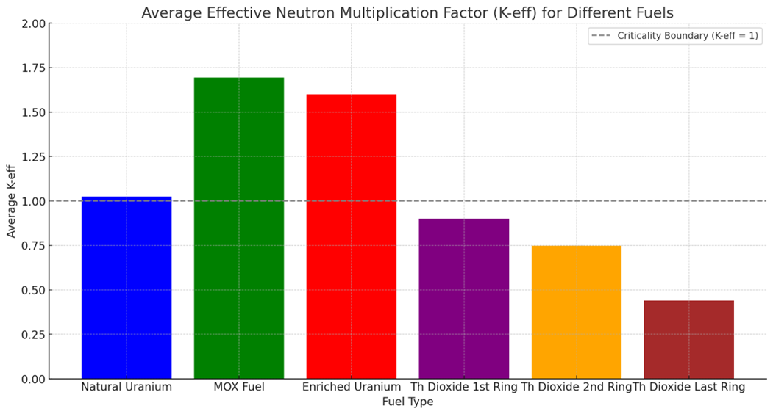

Slide 10
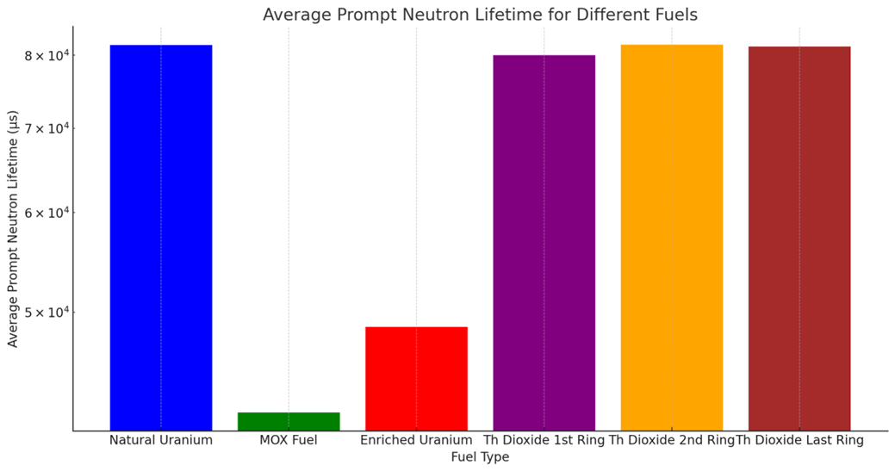

Slide 11
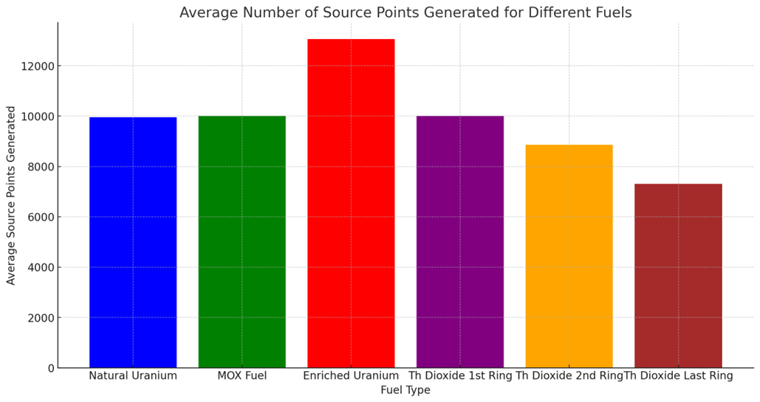

Slide 12
CONCLUSION
Demonstrates the reactivity and controllability differences between various fuel types in a CANDU reactor. MOX and enriched uranium fuels exhibit higher reactivity, requiring careful control, while natural uranium and thorium dioxide configurations are less reactive, with thorium configurations being subcritical.
Indicates that while traditional natural uranium fuel provides stable and efficient operation in CANDU reactors, there are opportunities for enhanced power output and efficiency through the use of MOX or enriched uranium fuels, albeit with necessary considerations for control and safety. Thorium dioxide, despite its lower reactivity, presents interesting potential for future fuel cycle innovations.

Slide 13
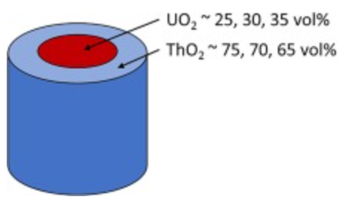
MOVING FURTHER
Incorporate burnup calculations
Refine material definitions
Refine neutron transportations model
Incorporate reactor kinetics
Further research on how would the arrangements impact the simulation result
Duplex fueling in fuel rod/pellet level
Notes:
Burnup calc, to track the depletion of nuclear fuel over time, to have insights about changes in isotopic compositions, fuel performance, etc.
More accurately define all components: fuel, cladding, moderator, coolant, etc
Neutron moderation, scattering etc
Simulating transient behaviour, such as reactor start, shutdown, reactivity insertions, etc.
Originally, we were computing results starting by first cell to 36th, and as the number of fuel pin that is replaced with thorium we have observed the differences as number of thorium fuel pin increases. But we later realized that the specific arrangements of how these different number of thorium pins placed in natural uranium pins would have significant impact on the simulation result. So our trial-and-error method of simply replacing existing uranium fuel pin to thorium were simply.... not ideal, at best. Further research showed that duplex pellet/pins were more studied in depth, of which was in fuel pin /pellet level. The entire fuel pins would be changed so that the specific arrangement is not a concern anymore, but, the issue here would be considering different shape of pin, different fuel material composition; of Uranium 235, 238 and Thorium 232.

